Slide 1
Hospitality Analysis Report
by :-
Amitkumar AnantaKumar Jena

Slide 2
Aim :-
XYZ Hotels is a luxury hotel chain operating in multiple locations India. They aim to optimize guest satisfaction, revenue, and operational efficiency through data-driven insights.
Challenge :-
XYZ Hotels faced challenges in gaining actionable insights from their operational data, including guest bookings, room occupancy, revenue streams, and guest feedback. They needed a solution to analyze and visualize these data points comprehensively to enhance decision-making and improve overall performance

Slide 3
Some Insight from the Data
Revenue
Bangalore City generates the highest revenue, covering 40% of the total revenue, whereas Delhi has the lowest revenue at 18%.
Mumbai City has the highest RevPAR at 9k, while Hyderabad has the lowest RevPAR at 5.5k.
Atliq Exotica has the highest revenue, whereas Atliq Season has the lowest revenue.
Revenue from Makemytrip is the highest at 341M.
The Presidential suite has the highest RevPAR at 14k, while the Stand suite has the lowest RevPAR at 4.6k.
On weekends, such as Saturday and Sunday, there is a spike in revenue, whereas there is a decline in revenue on weekdays.
Bookings are directly proportional to revenue.
Occupancy
Delhi City has the highest occupancy rate at 60%, while Bangalore has the lowest at 55.5%.
Atliq Blu has the highest occupancy rate at 62%, whereas Atliq Season has the lowest at 44.5%.
Occupancy rates by room class are relatively similar across most room classes.
Similar to revenue trends, weekends have the highest occupancy rate (73.58%), while weekdays have the lowest occupancy rate (51.34%).

Slide 4
Some Insight from the Data
Others
We observe similar trends in the cancellation rate, which is 24.5% across every city, both on weekends and weekdays.
We also notice a consistent pattern in the guest ratings, with an average rating of 3.62 across all cities, regardless of whether it's a weekday or a weekend.

Slide 5
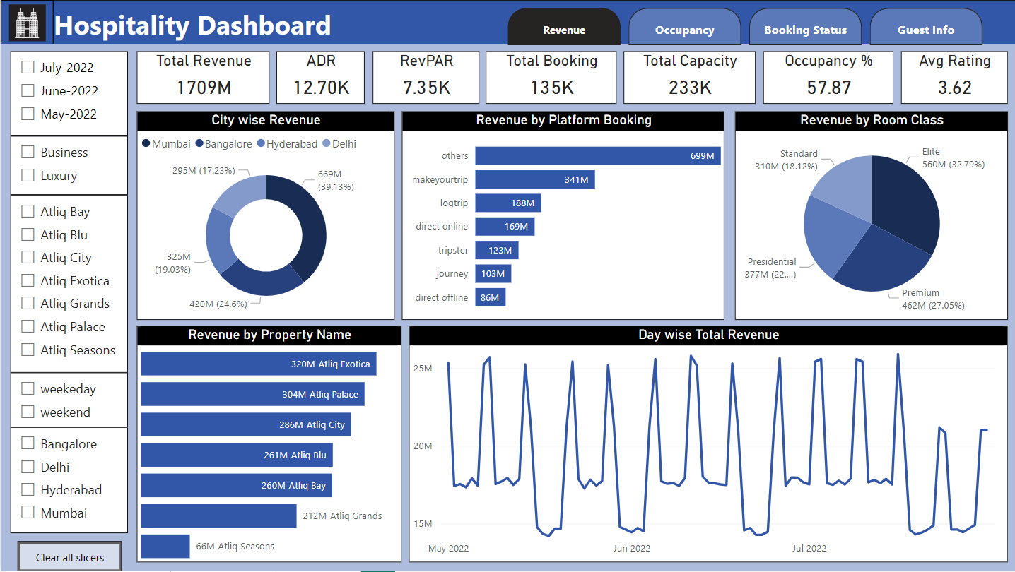
Power BI Dashboard

Slide 6
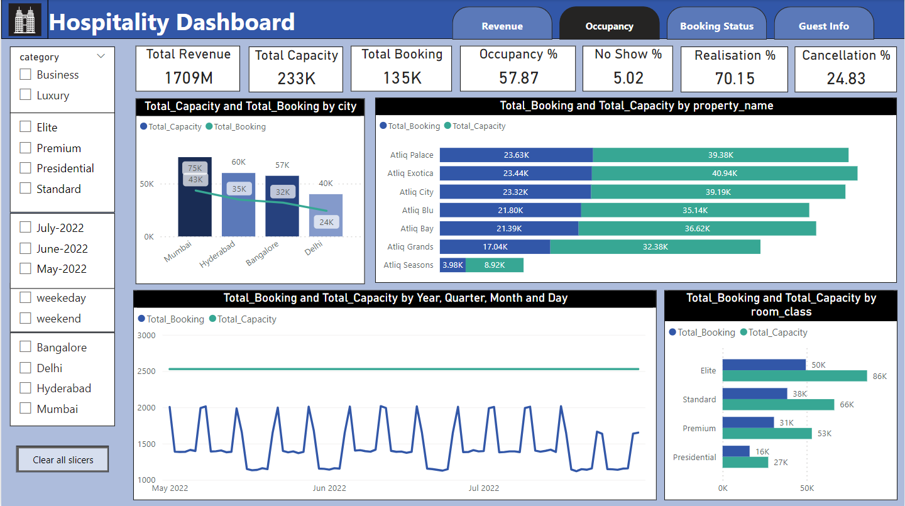
Power BI Dashboard Contd…

Slide 7
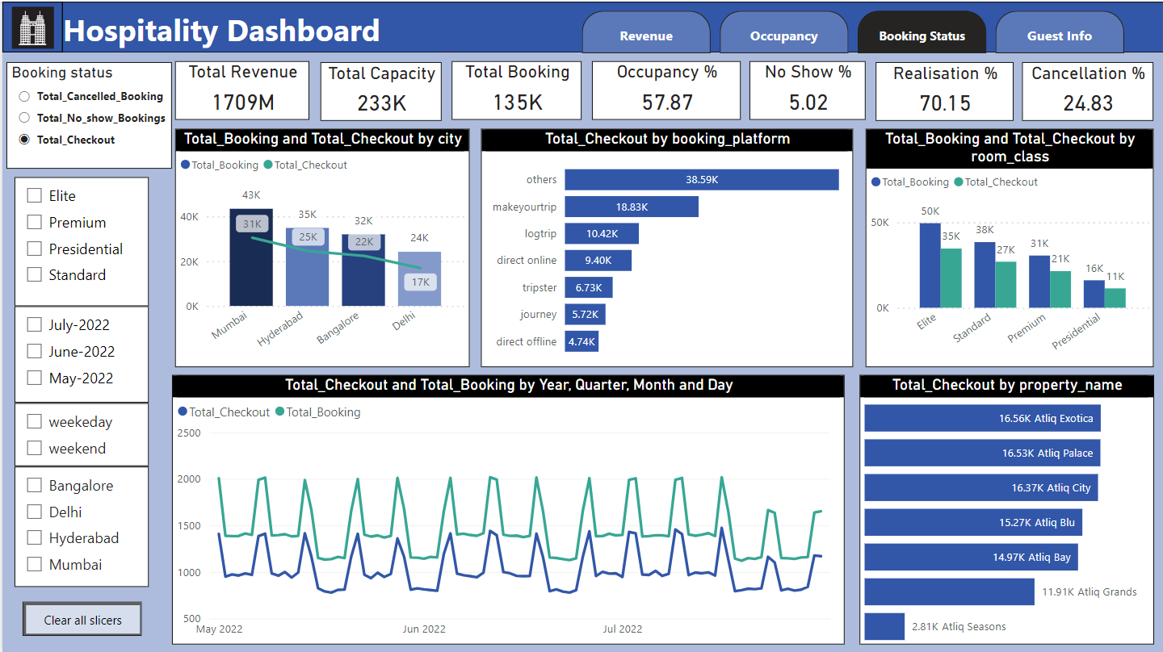
Power BI Dashboard Contd…

Slide 8
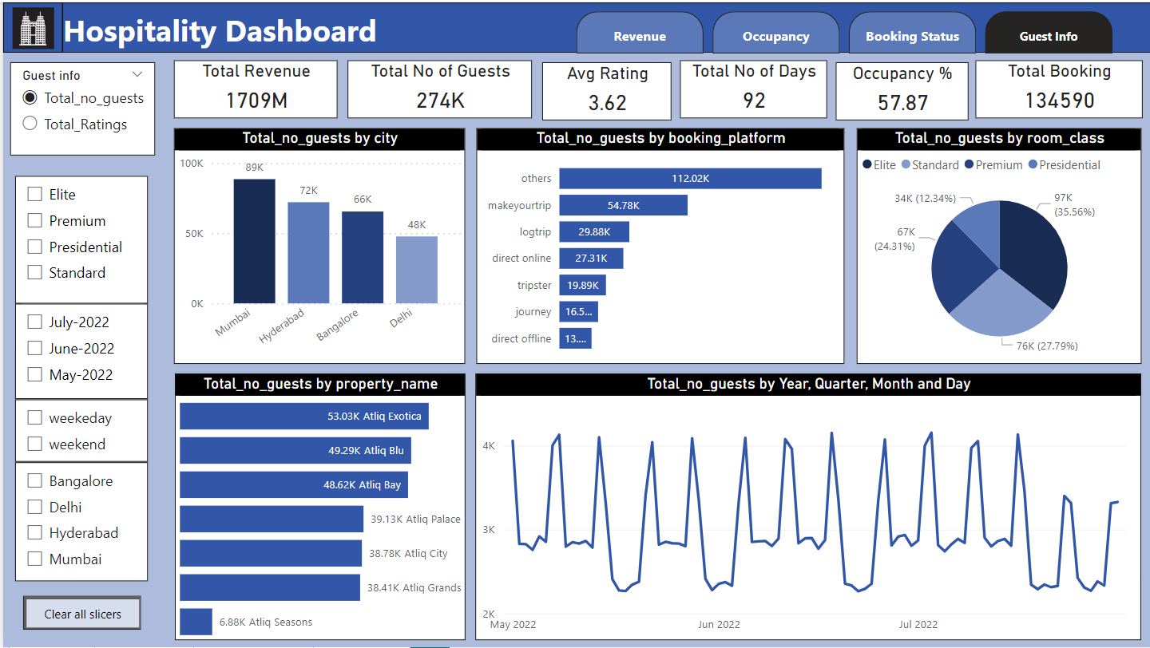
Power BI Dashboard Contd…

Slide 9
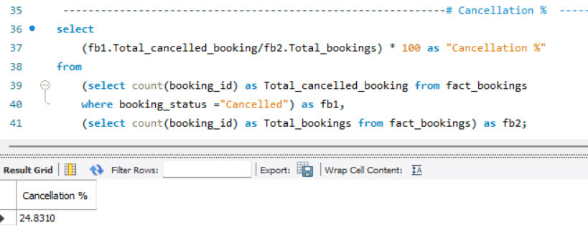
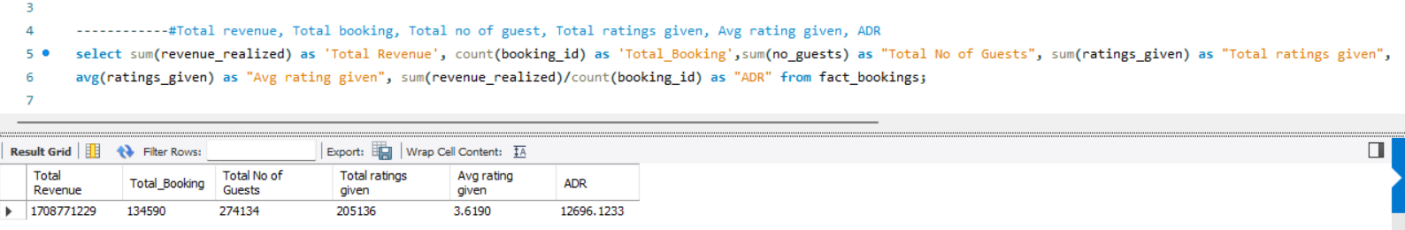
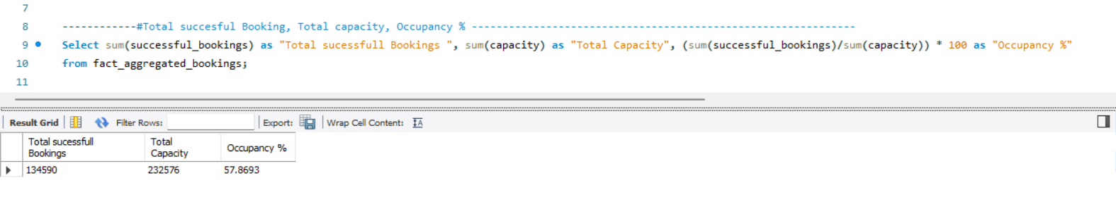
SQL Queries

Slide 10
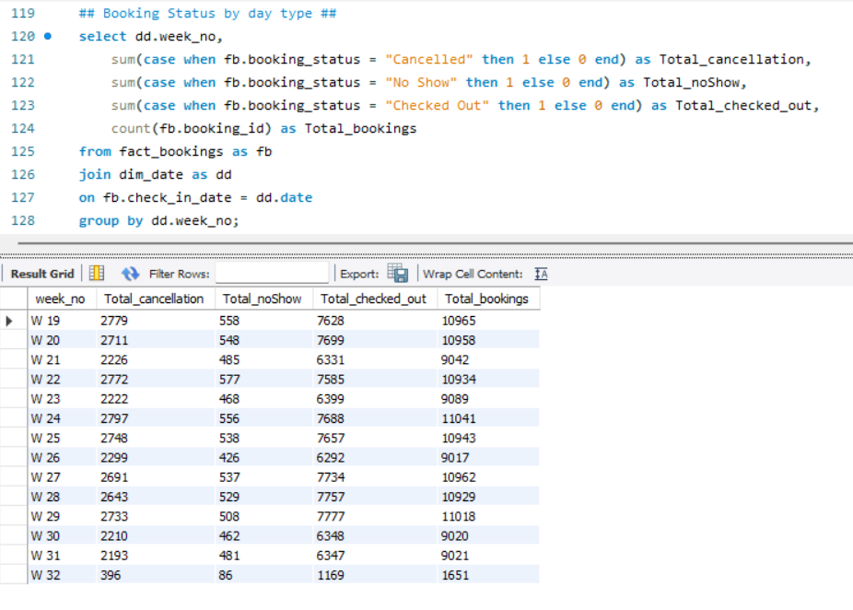
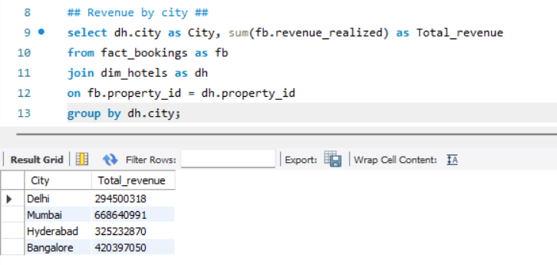
SQL Queries contd…

Slide 11
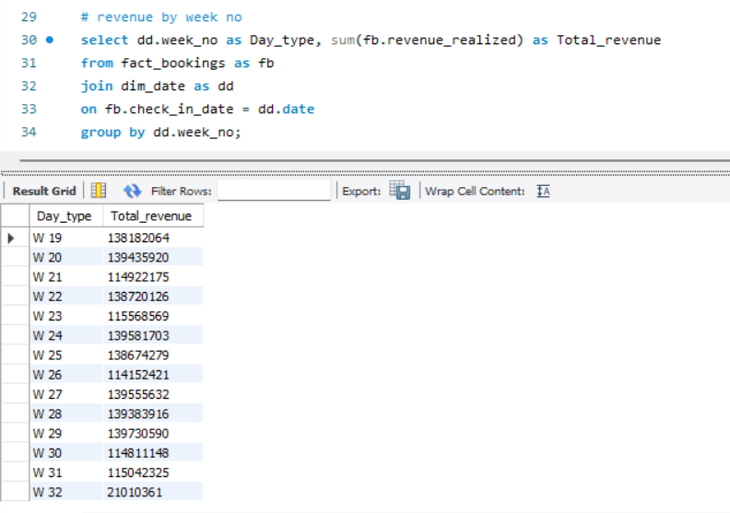
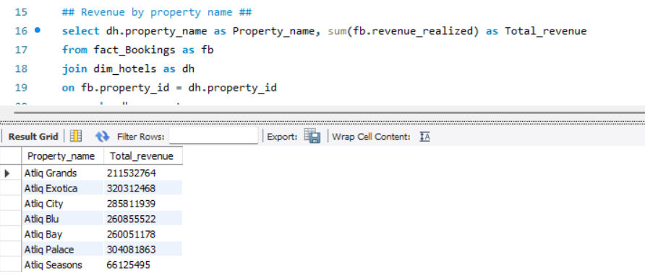
SQL Queries contd…

Slide 12
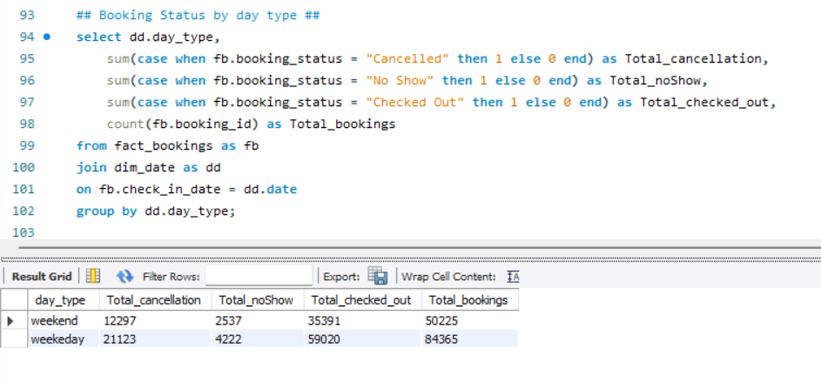
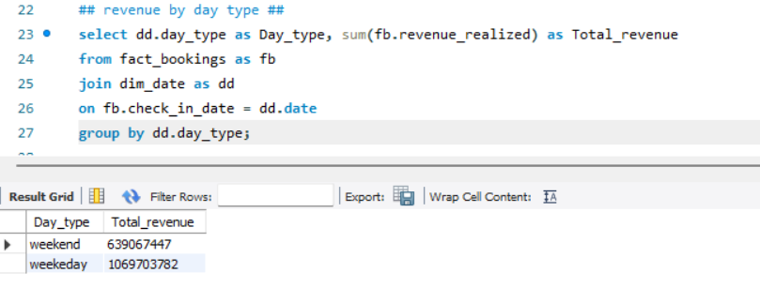
SQL Queries contd…

Slide 13
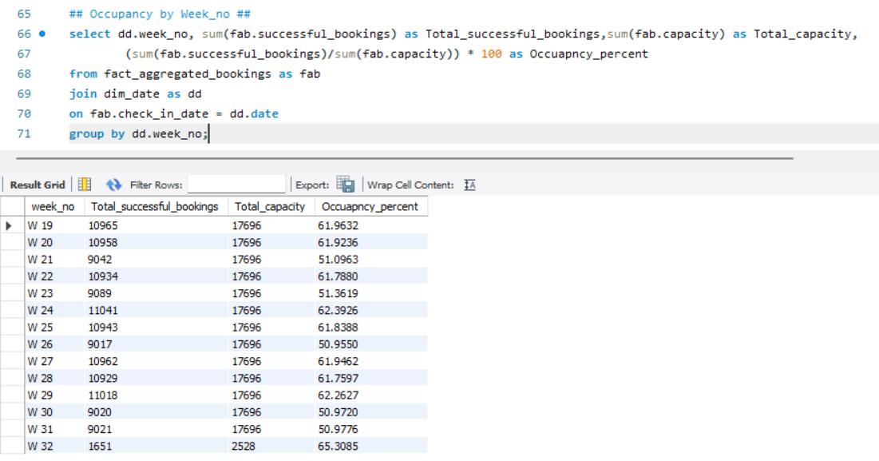
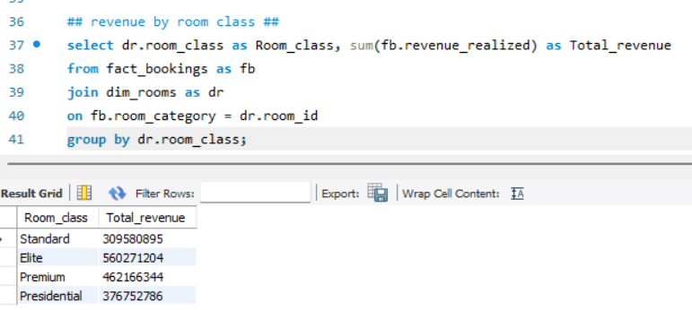
SQL Queries contd…

Slide 14
Some key takeaways and for improving performance and profitability:
Reduce Cancellation Rates
Flexible Policies: Offer flexible booking and cancellation policies to attract more bookings while balancing the risk of cancellations.
Deposit Requirements: Implement deposit requirements for certain bookings to reduce the likelihood of cancellations.
Optimize Occupancy Rates
Dynamic Pricing Strategies: Implement revenue management systems that adjust room rates based on demand forecasts, competitor pricing, and historical data.
Promotional Offers: Use targeted promotions during off-peak periods to increase bookings and improve occupancy rates.
Increase Average Daily Rate (ADR)
Upselling and Cross-Selling: Train staff to upsell room categories and cross-sell services such as dining and spa treatments.
Package Deals: Create attractive package deals that bundle accommodation with additional services or local experiences.

Slide 15
Thank You…

